Slide 1

Prioritisation of emerging
contaminants by action category:
the NORMAN approach
WG Prioritisation of emerging substances (WG1)
Valeria Dulio valeria.dulio@ineris.fr
Peter von der Ohe, UBA peter.vonderohe@uba.de
December 2014

Slide 2
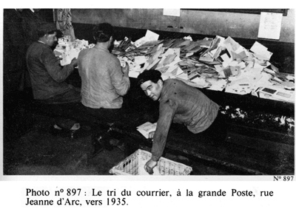
NORMAN prioritisation scheme
  Designed for emerging substances
  Addresses knowledge gaps
  Identifies actions needed
How does it work?

Slide 3
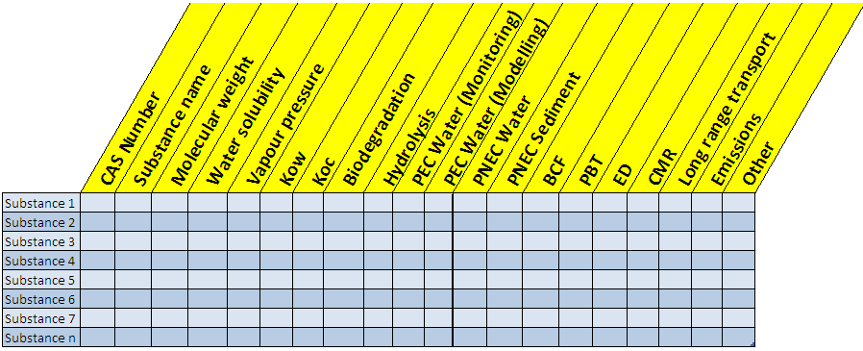
Typical steps / components of prioritisation schemes
Choosing the relevant parameters for prioritisation
Choosing the candidate substances
Filling in the database
Prioritisation algorithm
Adapted from V. Bonnomet , 2006

Slide 4

What to do when data is missing ?
?
Frequent conclusion of prioritisation exercises:
“…A large number of chemicals could not be prioritised due to a lack of either hazard or exposure data (or both)” (A. James. et al., 2009)

Slide 5
NORMAN approach: two main steps to tackle the problem of missing data
Categorisation of substances into action categories based on identified knowledge gaps
Prioritisation of substances within each category for further action

Slide 6
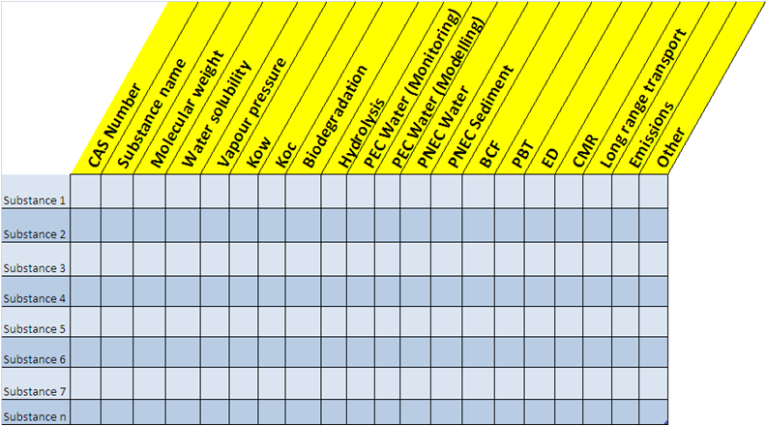

Categorisation of substances by identified knowledge gaps
Subs.1
Subs.2
Subs.3
Subs.4
Subs.5
Subs.6
Subs.7
Subs.n
Cat.1
Cat.2
Cat.3
Cat. n
F. Botta, 2014

Slide 7
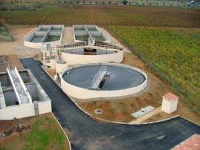
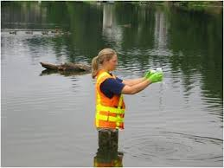
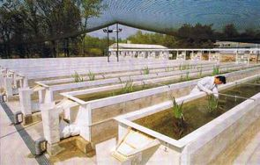
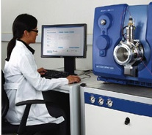
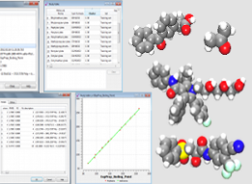
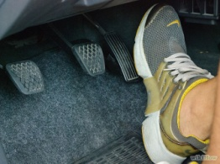
Action categories
1. Control / mitigation measures
2. Screening campaigns
3. Rigorous hazard assessment
4. Improvement of analytical methods
5. Screening AND hazard assessment
6. Reduced monitoring efforts

Slide 8


The overall approach
List of candidate substances
Data gathering, quality check, aggregation
Categorisation –
to allocate substances
to action categories
Exposure
Effects
Allocation to action categories
1
2
3
4
5
6
1
2
3
4
5
6
Prioritisation of substances within each category
2. Prioritisation – to define priorities within each action category
1
2
3
4
5
6
1
2
3
4
5
6
Subst.
1.
2.
3.
.
.
.
prioritised
by action
category
Actions implemented result in a new review process

Slide 9
LIST OF EMERGING SUBSTANCES
(NORMAN list)
≥ 4 countries AND ≥ 100 sites with analysis
≥ 20 sites analysis > LOQ in the relevant matrix(ces) +
Recent data (>last 6 years) ?
Insuff. (or never) monitored OR monitored in „wrong“ matrix
Suff. monitored but low frequency of quantification
Suff. monitored. & quantif. in relevant matrix
Categorisation of substances
LOQmax< PNEC (existing data in EMPODAT)?
Sufficient experimental data for hazard assesment?
yes
no
yes
no
LOQmin (EMPODAT) OR
LOQ expert labs < PNEC ?
Risk of exceedance of the
Lowest PNEC ?
yes
no
yes
Sufficient experimental data for hazard assesment?
no
yes
no
Cat. 6:
Non-priority for regular monitoring
Cat. 1:
Priority regular monitoring
Cat. 3: Action (eco)tox
Cat. 2:
Watch list
Cat. 4: Action analytical
Cat. 5
Novel end points

Slide 10
Grouping of substances by degree of investigation and evidence of exposure at European level
4 groups identified :
sufficiently monitored and sufficiently quantified in the relevant matrix
sufficiently monitored in the relevant matrix, but with a low frequency of quantification
insufficiently monitored
never monitored (i.e. for which no data are available in the EMPODAT database or other existing datasets)
monitored in a matrix that is considered as “not relevant” for the given substance

Slide 11
Applied criteria for exposure assessment at European level (ref. NORMAN Framework)
« Suff. level of investigation » = Occurrence data available for :
  ≥ 4 countries AND
  ≥ 100 sites
« Sufficient evidence of exposure » = Occurrence data available for :
  ≥ 20 sites with analysis > LOQ
  Measured in the relevant matrix
  Recent data (from 2005 in this exercise)

Slide 12
Grouping of substances by degree of investigation and evidence of exposure

Slide 13
Risk indicators
Extent of Exceedance = MEC95 / Lowest PNEC
to address the intensity of impact
where:
  MEC95 (95th percentile of the max conc. at each site)
  Lowest PNEC
  Equivalent to PEC/PNEC!
Score for „Exceedance of environmental threshold“
MEC95/lowest PNEC <1 = 0
10≥ MEC95/lowest PNEC≥1 =0.1
100≥ MEC95/lowest PNEC>10 = 0.2
1000≥ MEC95/lowest PNEC>100 =0.5
MEC95/lowest PNEC>1000 = 1

Slide 14
Risk indicators
  Frequency of Exceedance = n / N
  to address the spatial exposure aspects
where:
  n is the number of sites with MECsite > Lowest PNEC
  N is the total number of sites where the substance was measured
Score: value between 0 and 1
- Cat. 1, 3, 6: calculated using RECENT DATA
- Cat. 2, 4, 5: calculated using ALL DATA (all YEARS)

Slide 15
Conclusions
The NORMAN Prioritisation framework:
is applicable at different geographical scales (European, national, river basin level)
provides a decision-support framework for updating lists of substances for which actions (reduction, monitoring, research) are to be undertaken as a matter of priority
Further improvement are under way as regards:
  Integration with chemical non-target screening and bioassays-based tools in order to improve the list of candidate substances
  Exposure index: introduction of a surrogate for missing monitoring data at EU level
Going beyond PEC/PNEC ratios for individual substances

Slide 16
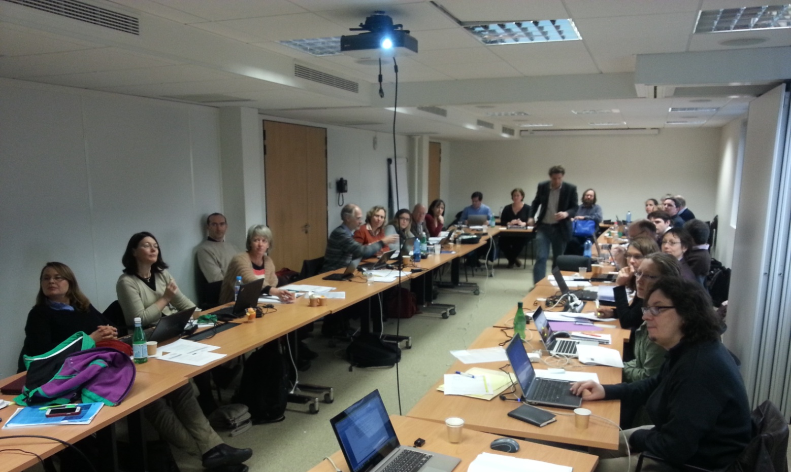
WG Prioritisation of emerging substances (WG1)

Slide 17
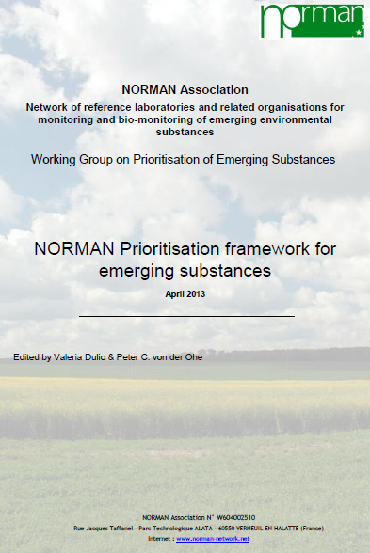
Leaders of the activity
Valeria Dulio - INERIS, FR |  | Working Group leader
Peter C. Von der Ohe, UBA, DE |  | Ecotoxicity sub-group leader
Anja Derksen - AD eco advice, NL |  | Ecotoxicity sub-group leader
Working Group experts
Marlene Ågerstrand | Stockholm University |  | SE
Laurence Amalric | BRGM |  | FR
Sandrine Andres | INERIS |  | FR
Ludek Blaha | Recetox |  | CZ
Werner Brack | UFZ |  | DE
Eva Brostrom | IVL |  | SE
Hélène Budzinski | University of Bordeaux |  | FR
Stellan Fisher | KEMI |  | SE
James Franklin | PlasticsEurope |  | EU
Armelle Hebert | VEOLIA Environnement |  | FR
Juliane Hollender | EAWAG |  | CH
Valérie Ingrand | VEOLIA Environnement |  | FR
Alice James-Casas | INERIS |  | FR
Martin Keller | BfG |  | DE
Vera Ocenaskova | T. G. Masaryk Water Research Inst. |  | CZ
Willie Peijnenburg | RIVM |  | NL
Zuzana Rabova | Recetox |  | CZ
Patrick Roose | MUMM |  | BE
Heinz Ruedel | Fraunhofer-IME |  | DE
Merijn Schriks | KWR |  | NL
Dieter Schudoma | UBA |  | DE
Jaroslav Slobodnik | EI |  | SK
Pierre-François Staub | ONEMA |  | FR

