Slide 1
Workshop 2011
Linked Data
A Dynamic Interface for Chemical and
Environmental Information
in Germany
Gerlinde Knetsch
Federal Environment Agency
Unit IV 2.1
Information Systems on Chemicals
Norman Workshop 2011 April 21st

Slide 2
Let me start with a quotation ….
Key Massages of the last workshop …
4.1.1. Accessibility/availability of monitoring data
Common data format (concentration + metadata) needed to improve interoperability of databases and
enhance exploitation of available monitoring data
4.1.2. Accessibility/availability of ecotox data
Exchange of ecotoxicological data at EU level needed
A common exchange platform at EU level is needed to improve interoperability.
There is a wish to have a list of databases for ecotoxicological endpoints, including meta information, on data quality, effect modifying parameters, compartment, internet links, etc.

Slide 3
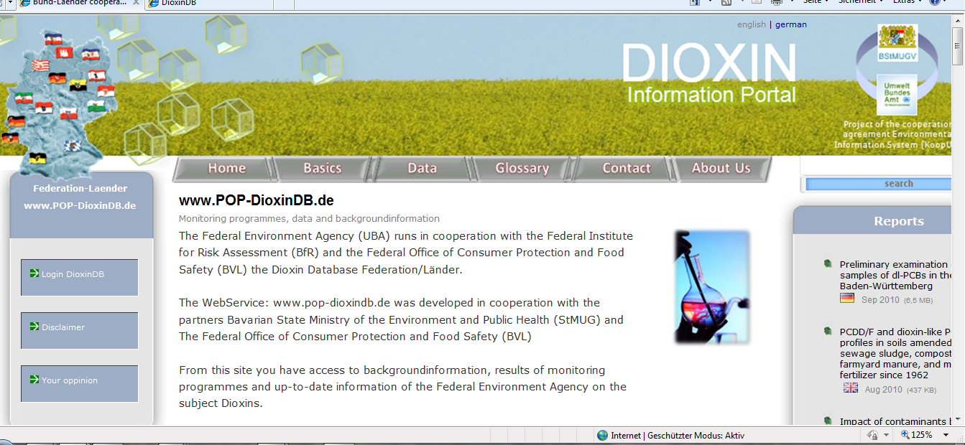
4.1.1. Accessibility/availability of monitoring data
Databases special content e.g. OSPAR database, Water Quality database, Environmental Specimen Bank….
Information Portal of Persistent Organic Pollutants (POP-Portal)

Slide 4
Information Portal of Persistent Organic Pollutants (POP-Portal)
Central platform to online information about POPs AND supplies the retrieval of data and information for environmental monitoring data of POPs to a joint database
generating a general view of the contamination of humans and the environment by POPs
making comments on trends of contamination of environmental media and humans
documentation and control of the success of environmental measures initiated to reduce the input of dioxins into environment and the exposition of dioxins to humans.
Up-to-date, comprehensive and reliable information on the environmental properties of chemical substances and preparations is of immense importance for all areas of environmental protection and for averting danger.
Norman Workshop 2011 April 21st Gerlinde Knetsch

Slide 5
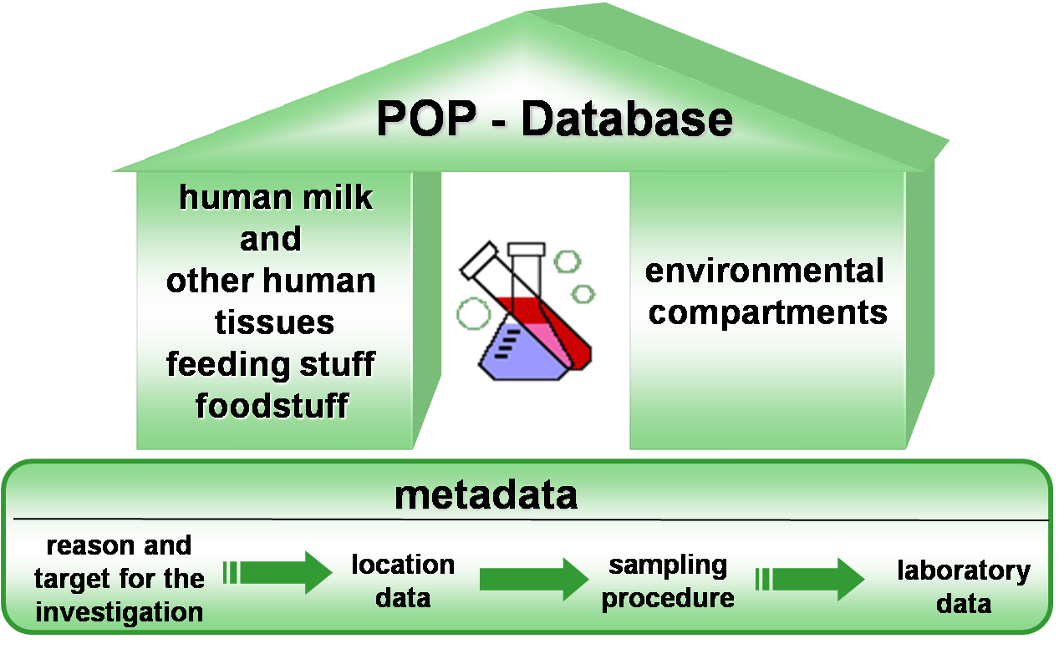

Slide 6
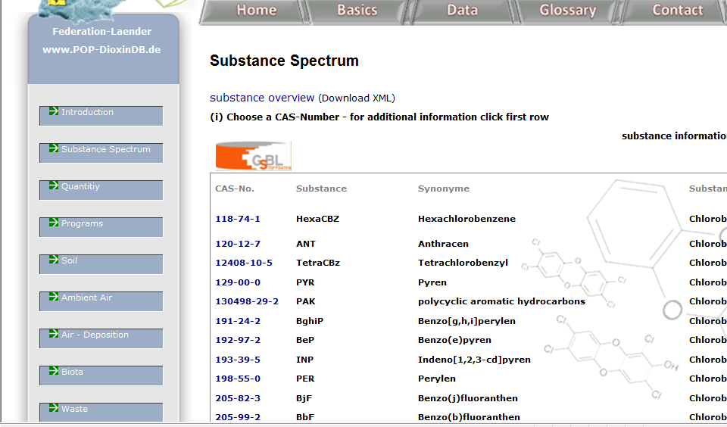

Slide 7
Joint Substance Data Pool of the German Federal
Government and the Federal States www.gsbl.de

Slide 8
Joint Substance Data Pool of the German Federal Government
and the Federal States www.gsbl.de
Central access point to a joint database of chemical information of immense importance for all areas of environmental protection and for averting danger.
Guide to:
up-to-date comprehensive and reliable chemical information of more than 60.000 pure substances and 320.000 component substances
information on the environmental properties of this chemical substances and preparations
inter alia ecotoxicological and toxicological data
190.000 contents of relevant legislation
Up-to-date, comprehensive and reliable information on the environmental properties of chemical substances and preparations is of immense importance for all areas of environmental protection and for averting danger.

Slide 9
4.1.2. Accessibility/availability of chemical information /ecotox data
Information Portal of Persistent Organic Pollutants (POP-Portal)

Slide 10
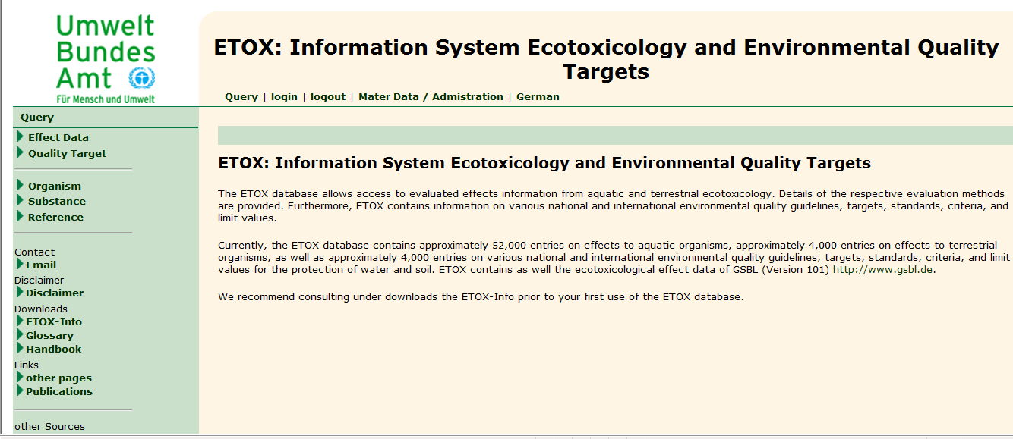
Information System Ecotoxicology and Environmental Quality Targets
ETOX

Slide 11
Technical aspects of the dynamic interface
Interoperability between monitoring data databases and chemical databases
WebServices to open databases for the access of other user groups (XML-structure)
First step: linked data via a key identifier CAS as a linked element via RegName of GSBL
monitoring data → chemical data → ecotoxicological data
BUT NO one way “Ticket”
bi-directional data linking – win-win situation

Slide 12
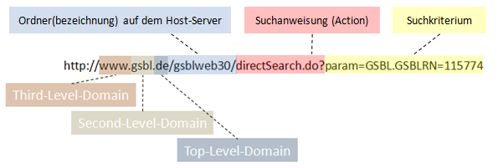
Technical aspects of the dynamic interface Example
www.gsbl.de/gsblweb30/
GSBL-Registriernummer 115774

Slide 13
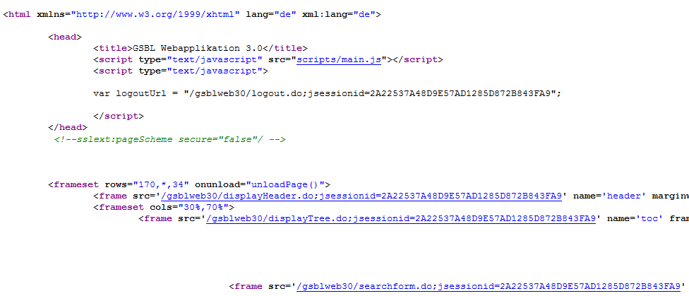

Slide 14
Technical aspects of the dynamic interface
Searching for the Code of the parameter (CAS-Nummer)
<td class="grid1content bc8">
CAS-Nummer
</td>
<td class="grid1content bc8">
<input type="hidden" name="combine[1]" value="und">
<input type="hidden" name="bracketopen[1]" value="">
<input type="hidden" name="field[1]" value="CASRN.CASRN">
<input type="hidden" name="operator[1]" value="=">
<input type="text" name="value[1]" value="" onkeypress="submitOnEnter(this,event)" class="bc2 textbox1">
<input type="hidden" name="bracketclose[1]" value="">
http://www.gsbl.de/gsblweb30/directsearch.do?param=CASRN.CASRN=Wert
Value in the field CASRN - Directlink:

Slide 15
More Information ????
Body-field of the source code:
<a href="http://www.gsbl.de/gsblweb30/directSearch.do?param=CASRN.CASRN=74472-37-0"
target="_blank" onclick="return pop('http://www.gsbl.de/gsblweb30/directSearch.do?
param=CASRN.CASRN=74472-37-0', 'pophelp', 'width=820', 'height=620', 'toolbar=no',
'location=no', 'directories=no', 'status=no', 'menubar=no', 'scrollbars=no', 'resizable=no');
">74472-37-0</a>
Are you interested in contact us !!!

Slide 16
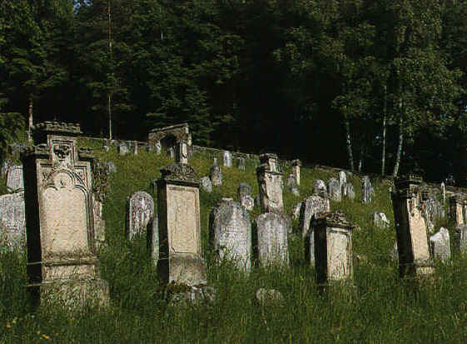
We don‘t need data cemeteries
We need „Linked Data“
with dynamic interfaces for exchange
112,34
-13,3
5,6
15
87,3

Slide 17
Information System Ecotoxicology and Environmental Quality Targets
ETOX
Central platform and access to a joint database to evaluated effects information from aquatic and terrestrial ecotoxicology.
4.000 Information on various national and international environmental quality guidelines, targets, standards, criteria, and limit values for the protection of water and soil. .
contains approximately 52,000 entries on effects to aquatic organisms, approximately 4,000 entries on effects to terrestrial organisms, as well as approximately
integrates ecotoxicological effect data of GSBL

