Slide 1

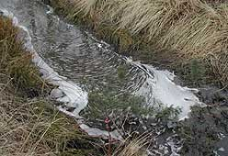

Swedish databases-Screening database
Katarina Hansson

Slide 2
Work with chemicals at IVL
Monitoring and screening
Data host-national databases
Emission measurements
Chemical analysis
SMED (Swedish Environmental Emissions Data)
Modelling
Development of guideline documents
EU-projects (e.g. COHIBA, SOCOPSE)
National research programmes (e.g. ChEmiTecs)

Slide 3
National monitoring data - data host
The Swedish EPA, as the funding body of the Swedish national environmental monitoring programme, owns the data collected
A data host stores, reviews, compiles and makes the environmental monitoring data available for the users
The major subject areas are:
  Air
  Freshwater
  Seas and coastal areas
  Agricultural lands
  Wetlands
  Toxic pollutants
  Health-related environmental monitoring and bathing water
  www.naturvardsverket.se

Slide 4

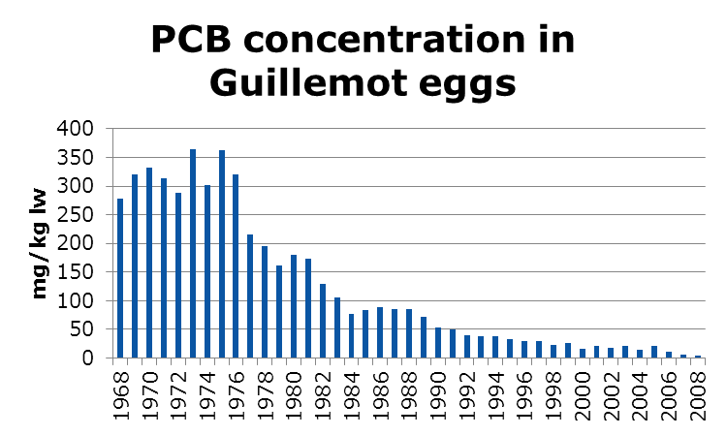
Biota database - Metals and organic pollutants in biological samples
National monitoring
Biota database
http://www.balticseabird.com/lankar.htm
Metals, Hg
PCB
PBDE
DDT
HCH
TBT
PAH
Dioxins/furans
Fish
Blue mussels
Guillemot eggs
Elk
Reindeer
Otter
etc.
Long series:
Frequent measurements
Same sampling sites
Same species

Slide 5
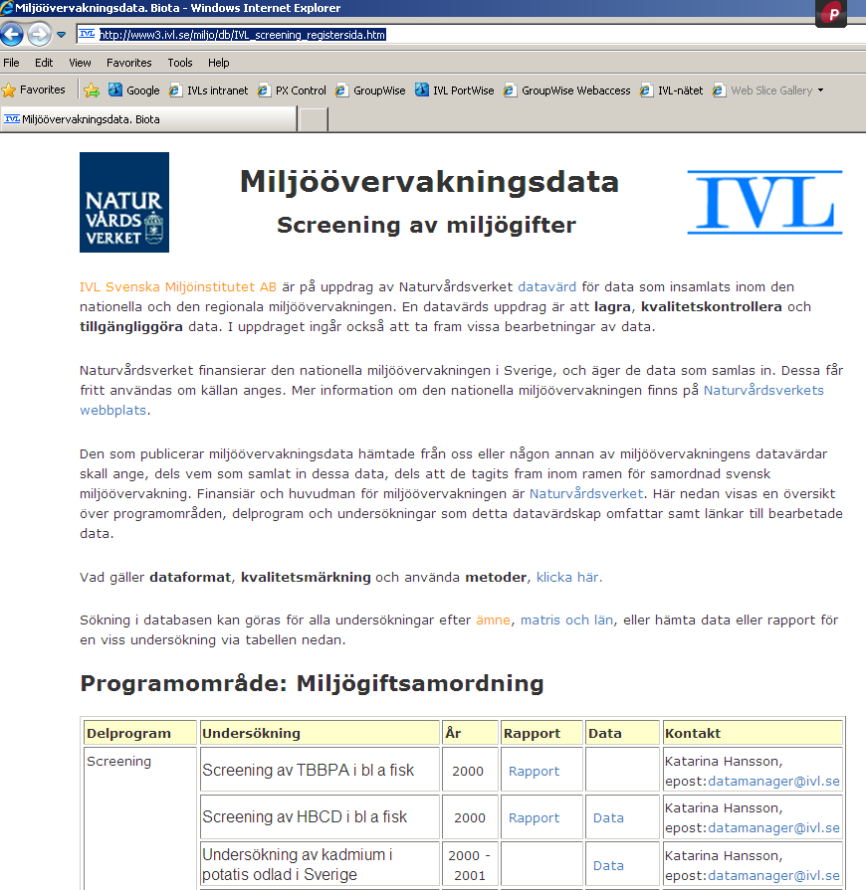
Screening database
  The database contain both national and regional data (http://www3.ivl.se/miljo/db/IVL_screening_registersida.htm)
  approximately 660 substances or substance groups
  100 000 samples in the database
  results from 100 different studies
  16 matrixes

Slide 6
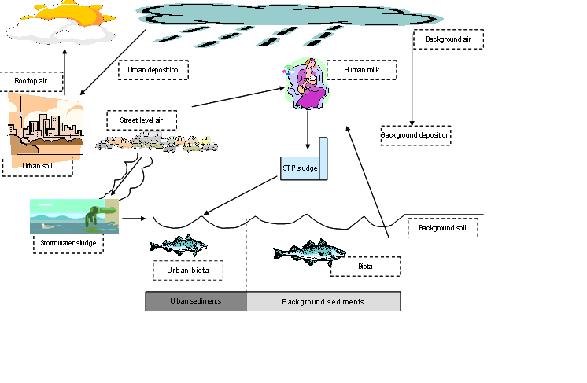
Screening study
Measurements of a chemical in approx. 50 samples divided in different matrices
The sampling strategy depends on the chemical

Slide 7
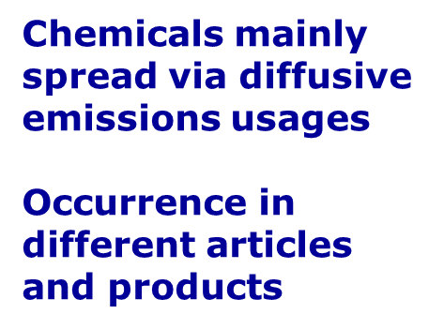
Overview
Emerging substances – widespread occurrence
Examples from IVLs screening studies

Slide 8
Screening database
The data is delivered in Excel forms
The screening reports are published together with the data
It is possible to search information in the database – substance, matrix or site
All data is available for the public
The database is in Swedish
The database is increasing with approximately 10 new studies each year
The data delivered to the database is of varying quality-some information may be missing
Analytical methods are not yet in the database-the information may be achieved from the reports

Slide 9
What is the data in the biota database and screening database used for?
Internationally:
  International reporting, ICES (only data from biota database)
  WISE – WFD PS
  NORMAN
Nationally:
  Public authorities, such as the Swedish EPA, Swedish Chemical Agency (KemI)
  Local authorities
  Scientists
  Students

Slide 10
Thank you!
Katarina Hansson
katarina.hansson@ivl.se

